Slide 1

COMPUTER NETWORKS
TEAM NETWORKS
Department of Computer Science and Engineering

Slide 2
COMPUTER NETWORKS
Transport Layer
TEAM NETWORKS
Department of Computer Science and Engineering

Slide 3
COMPUTER NETWORKS
Transport Layer - Roadmap
3.1 Transport-layer Services
3.2 Multiplexing and Demultiplexing
3.3 Connectionless Transport: UDP

Slide 4
COMPUTER NETWORKS
Transport Layer - Roadmap
3.1 Transport-layer Services
3.2 Multiplexing and Demultiplexing
3.3 Connectionless Transport: UDP

Slide 5








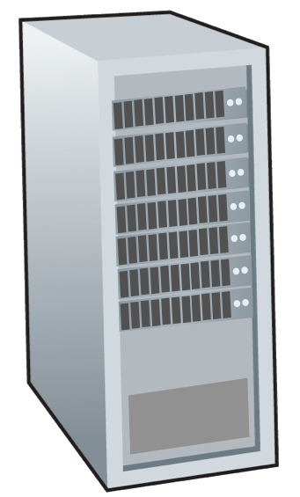







COMPUTER NETWORKS
Transport Services and Protocols
provide logical communication between application processes running on different hosts
application
transport
network
data link
physical
mobile network
national or global ISP
transport protocols actions in end systems:
sender: breaks application messages into segments, passes to network layer
receiver: reassembles segments into messages, passes to application layer
logical end-end transport
local or regional ISP
home network
content
provider
network
application
transport
network
data link
physical
datacenter
network
two transport protocols available to Internet applications
TCP, UDP
enterprise
network

Slide 6
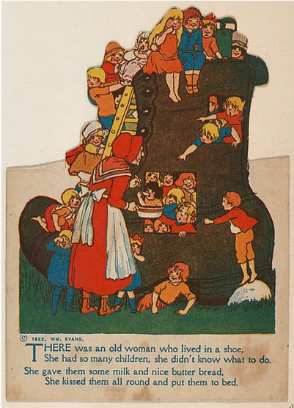
COMPUTER NETWORKS
Transport vs. Network Layer Services and Protocols
household analogy:
12 kids in Ann’s house sending letters to 12 kids in Bill’s house:
hosts = houses
processes = kids
app messages = letters in envelopes

Slide 7
COMPUTER NETWORKS
Transport vs. Network Layer Services and Protocols
household analogy:
network layer: logical communication between hosts
transport layer: logical communication between processes
relies on, enhances, network layer services
12 kids in Ann’s house sending letters to 12 kids in Bill’s house:
hosts = houses
processes = kids
app messages = letters in envelopes

Slide 8
COMPUTER NETWORKS
Transport Layer Actions
Sender:
application
application
is passed an application-layer message
app. msg
determines segment header fields values
T_{h}
transport
app. msg
transport
T_{h}
creates segment
network (IP)
network (IP)
passes segment to IP
link
link
physical
physical

Slide 9
COMPUTER NETWORKS
Transport Layer Actions
Receiver:
application
receives segment from IP
application
checks header values
transport
transport
app. msg
extracts application-layer message
network (IP)
network (IP)
demultiplexes message up to application via socket
link
link
physical
physical
app. msg
T_{h}

Slide 10
COMPUTER NETWORKS
Principal Internet Transport Layer protocols
TCP: Transmission Control Protocol
reliable, connection oriented
in-order delivery
congestion control
flow control
connection setup
UDP: User Datagram Protocol
unreliable, connectionless
unordered delivery
no-frills extension of “best-effort” IP
services not available:
delay guarantees
bandwidth guarantees
application
transport
network
data link
physical
mobile network
national or global ISP
logical end-end transport
local or regional ISP
home network
content
provider
network
application
transport
network
data link
physical
datacenter
network
enterprise
network

Slide 11

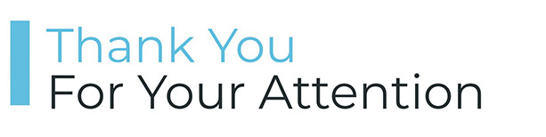
COMPUTER NETWORKS
Suggested Readings
Transport Layer – Explained – https://youtu.be/FxFJ1XlWtdI
Transport Layer Services – IIT Kharagpur –https://youtu.be/8-3CSAkscYU
Transport Layer – Process to Process Delivery – https://youtu.be/9e4vTcaEYCg

Slide 12
COMPUTER NETWORKS
Transport Layer - Roadmap
3.1 Transport-layer Services
3.2 Multiplexing and Demultiplexing
3.3 Connectionless Transport: UDP
Extending host-to-host delivery to process-to-process delivery

Slide 13





COMPUTER NETWORKS
Multiplexing and Demultiplexing
HTTP server
client
application
application
HTTP msg
transport
transport
network
transport
network
link
network
link
physical
link
physical
physical

Slide 14
COMPUTER NETWORKS
Multiplexing and Demultiplexing
HTTP server
client
application
application
HTTP msg
transport
H_{t}
HTTP msg
transport
network
transport
network
link
network
link
physical
link
physical
physical

Slide 15
COMPUTER NETWORKS
Multiplexing and Demultiplexing
HTTP server
client
application
application
HTTP msg
transport
H_{t}
HTTP msg
H_{n}
H_{t}
network
transport
HTTP msg
transport
network
link
network
link
physical
link
physical
physical

Slide 16
COMPUTER NETWORKS
Multiplexing and Demultiplexing
HTTP server
client
application
application
transport
transport
network
transport
network
link
network
link
physical
link
physical
physical
H_{n}
H_{t}
HTTP msg

Slide 17

COMPUTER NETWORKS
Multiplexing and Demultiplexing
HTTP server
client₁
client₂
application
P-client₁
P-client₂
application
transport
transport
network
transport
network
link
network
link
physical
link
physical
physical

Slide 18
COMPUTER NETWORKS
Multiplexing and Demultiplexing
multiplexing at sender:
demultiplexing at receiver:
handle data from multiple
sockets, add transport header (later used for demultiplexing)
use header info to deliver
received segments to correct
socket
application
application
P1
P2
application
socket
P3
transport
P4
process
transport
network
transport
network
link
network
link
physical
link
physical
physical

Slide 19
COMPUTER NETWORKS
How demultiplexing works
host receives IP datagrams
each datagram has source IP address, destination IP address
each datagram carries one transport-layer segment
each segment has source, destination port number
host uses IP addresses & port numbers to direct segment to appropriate socket
32 bits
source port #
dest port #
other header fields
application
data
(payload)
TCP/UDP segment format
Each port number - ranges from 0 to 65535.
Port numbers ranging from 0 to 1023 are called well-known port numbers (restricted/reserved)

Slide 20
COMPUTER NETWORKS
Connectionless demultiplexing
Recall:
when creating socket, must specify host-local port #:
DatagramSocket mySocket1 = new DatagramSocket(12534);
when receiving host receives UDP segment:
checks destination port # in segment
directs UDP segment to socket with that port #
when creating datagram to send into UDP socket, must specify
destination IP address
destination port #
IP/UDP datagrams with same dest. port #, but different source IP addresses and/or source port numbers will be directed to same socket at receiving host

Slide 21
COMPUTER NETWORKS
Connectionless demultiplexing: example
DatagramSocket serverSocket = new DatagramSocket (6428);
DatagramSocket mySocket2 = new DatagramSocket
(9157);
DatagramSocket mySocket1 = new DatagramSocket (5775);
application
application
P1
application
P3
P4
transport
transport
network
transport
network
link
network
link
physical
link
physical
physical
source port: 6428
dest port: 9157
source port: ?
dest port: ?
source port: 9157
dest port: 6428
source port: ?
dest port: ?

Slide 22
COMPUTER NETWORKS
Connection-oriented demultiplexing
TCP socket identified by 4-tuple:
source IP address
source port number
dest IP address
dest port number
demux: receiver uses all four values (4-tuple) to direct segment to appropriate socket
server host may support many simultaneous TCP sockets:
each socket identified by its own 4-tuple
web servers have different sockets for each connecting client
non-persistent HTTP will have different socket for each request

Slide 23
COMPUTER NETWORKS
Connection-oriented demultiplexing: example
application
application
P4
P5
P6
application
P1
P2
P3
transport
transport
network
transport
network
link
network
link
physical
link
physical
server: IP address B
physical
host: IP address A
source IP,port: B,80
dest IP,port: A,9157
host: IP address C
source IP,port: C,5775
dest IP,port: B,80
source IP,port: A,9157
dest IP, port: B,80
source IP,port: C,9157
dest IP,port: B,80
Three segments, all destined to IP address: B, dest port: 80 are demultiplexed to different sockets

Slide 24
COMPUTER NETWORKS
Summary
Multiplexing, demultiplexing: based on segment, datagram header field values
UDP: demultiplexing using destination port number (only)
TCP: demultiplexing using 4-tuple: source and destination IP addresses, and port numbers
Multiplexing/demultiplexing happen at all layers

Slide 25

COMPUTER NETWORKS
Quiz
How many TCP connections can a server handle?

Slide 26
COMPUTER NETWORKS
Suggested Readings
Transport Layer Multiplexing and Demultiplexing
https://youtu.be/hgWCMry9EYo
Transport Layer – Process to Process Delivery – https://youtu.be/9e4vTcaEYCg

Slide 27
COMPUTER NETWORKS
Transport Layer - Roadmap
3.1 Transport-layer Services
3.2 Multiplexing and Demultiplexing
3.3 Connectionless Transport: UDP

Slide 28
COMPUTER NETWORKS
UDP: User Datagram Protocol
“no frills,” “bare bones” Internet transport protocol
“best effort” service, UDP segments may be:
lost
delivered out-of-order to app
Why is there a UDP?
no connection establishment (which can add RTT delay)
no connection state at sender, receiver (buffer, seq, ack, c-c parameters)
small header size (8 vs 20 bytes)
no congestion control
UDP can blast away as fast as desired!
can function in the face of congestion
connectionless:
no handshaking between UDP sender, receiver
each UDP segment handled independently of others

Slide 29
COMPUTER NETWORKS
UDP: User Datagram Protocol [RFC 768]
UDP use:
streaming multimedia apps (loss tolerant, rate sensitive)
DNS
SNMP
HTTP/3
if reliable transfer needed over UDP (e.g., HTTP/3):
add needed reliability at application layer
add congestion control at application layer

Slide 30
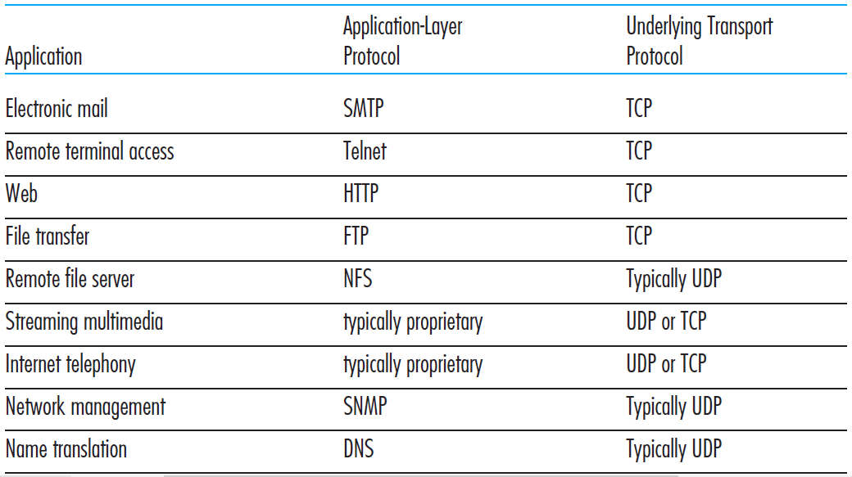
COMPUTER NETWORKS
Popular Internet Applications using TCP/UDP

Slide 31
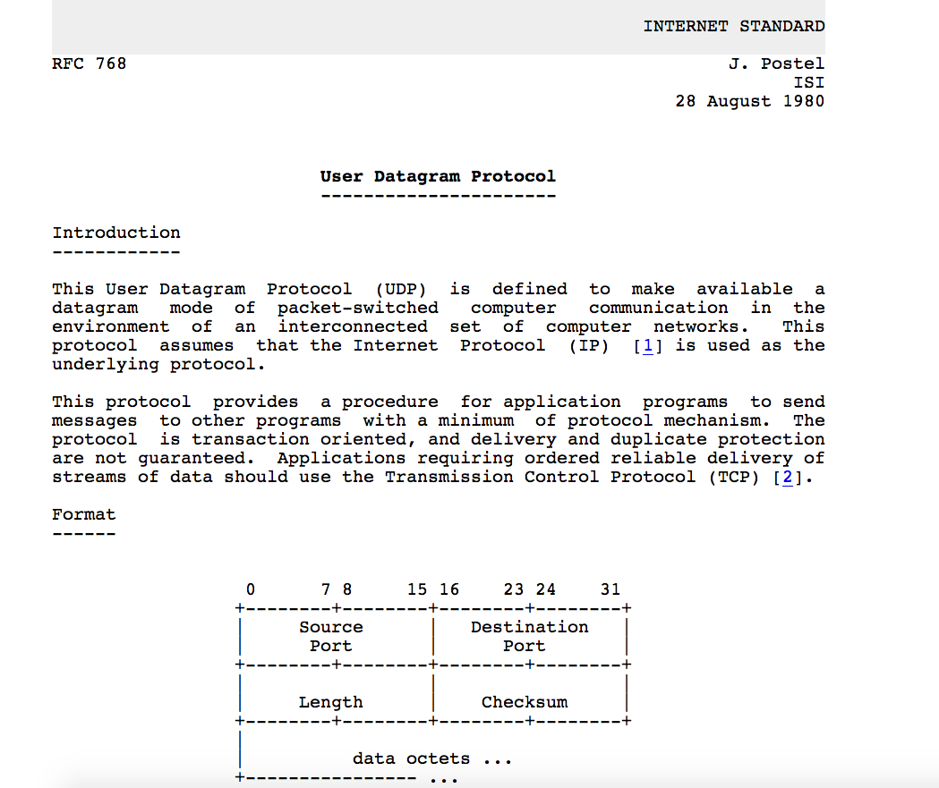
COMPUTER NETWORKS
UDP: User Datagram Protocol [RFC 768]

Slide 32
COMPUTER NETWORKS
UDP: Transport Layer Actions
SNMP client
SNMP server
application
application
transport
(UDP)
transport
(UDP)
network (IP)
network (IP)
link
link
physical
physical

Slide 33
COMPUTER NETWORKS
UDP: Transport Layer Actions
SNMP client
SNMP server
UDP sender actions:
application
application
is passed an application-layer message
SNMP msg
transport
(UDP)
transport
(UDP)
determines UDP segment header fields values
UDP_{h}
SNMP msg
UDP_{h}
creates UDP segment
network (IP)
network (IP)
passes segment to IP
link
link
physical
physical

Slide 34
COMPUTER NETWORKS
UDP: Transport Layer Actions
SNMP client
SNMP server
UDP receiver actions:
application
receives segment from IP
application
checks UDP checksum header value
transport
(UDP)
transport
(UDP)
SNMP msg
extracts application-layer message
network (IP)
network (IP)
SNMP msg
UDP_{h}
demultiplexes message up to application via socket
link
link
physical
physical

Slide 35
COMPUTER NETWORKS
UDP: segment header
length, in bytes of UDP segment, including header
32 bits
source port #
dest port #
length
checksum
application
data
(payload)
UDP segment format

Slide 36

COMPUTER NETWORKS
UDP Checksum
Goal: detect “errors” (e.g., flipped bits) in transmitted segment
1st number
2nd number
sum
Transmitted: 5 6 11
Received: 4 6 11
receiver-computed
checksum
=
sender-computed
checksum (as received)

Slide 37
COMPUTER NETWORKS
UDP Checksum
Goal: detect errors (i.e., flipped bits) in transmitted segment
sender:
treat contents of UDP segment (including UDP header fields and IP addresses) as sequence of 16-bit integers
checksum: addition (one’s complement sum) of segment content
checksum value put into UDP checksum field
receiver:
compute checksum of received segment
check if computed checksum equals checksum field value:
Not equal - error detected
Equal - no error detected. But maybe errors nonetheless? More later ….

Slide 38
COMPUTER NETWORKS
Internet Checksum: example
example: add two 16-bit integers
1 1 1 0 0 1 1 0 0 1 1 0 0 1 1 0
1 1 0 1 0 1 0 1 0 1 0 1 0 1 0 1
wraparound
1 1 0 1 1 1 0 1 1 1 0 1 1 1 0 1 1
sum
1 0 1 1 1 0 1 1 1 0 1 1 1 1 0 0
checksum
0 1 0 0 0 1 0 0 0 1 0 0 0 0 1 1
Note: when adding numbers, a carryout from the most significant bit needs to be added to the result
* Check out the online interactive exercises for more examples: http://gaia.cs.umass.edu/kurose_ross/interactive/

Slide 39
COMPUTER NETWORKS
Internet Checksum: Weak protection!
example: add two 16-bit integers
0 1
1 1 1 0 0 1 1 0 0 1 1 0 0 1 1 0
1 0
1 1 0 1 0 1 0 1 0 1 0 1 0 1 0 1
wraparound
1 1 0 1 1 1 0 1 1 1 0 1 1 1 0 1 1
Even though numbers have changed (bit flips), no change in checksum!
sum
1 0 1 1 1 0 1 1 1 0 1 1 1 1 0 0
checksum
0 1 0 0 0 1 0 0 0 1 0 0 0 0 1 1

Slide 40
COMPUTER NETWORKS
Internet Checksum: example
example: add three 16-bit integers
0 1 1 0 0 1 1 0 0 1 1 0 0 0 0 0
0 1 0 1 0 1 0 1 0 1 0 1 0 1 0 1
1 0 0 0 1 1 1 1 0 0 0 0 1 1 0 0
sum
0 1 0 0 1 0 1 0 1 1 0 0 0 0 1 0
checksum
1 0 1 1 0 1 0 1 0 0 1 1 1 1 0 1
Note: when adding numbers, a carryout from the most significant bit needs to be added to the result
* Check out the online interactive exercises for more examples: http://gaia.cs.umass.edu/kurose_ross/interactive/

Slide 41
COMPUTER NETWORKS
Suggested Readings
UDP – RFC 768 https://tools.ietf.org/html/rfc768
Networking - DNS and UDP https://youtu.be/vuyQ1PW6AwY

Slide 42
THANK YOU
Department of Computer Science and Engineering

